Slide 1
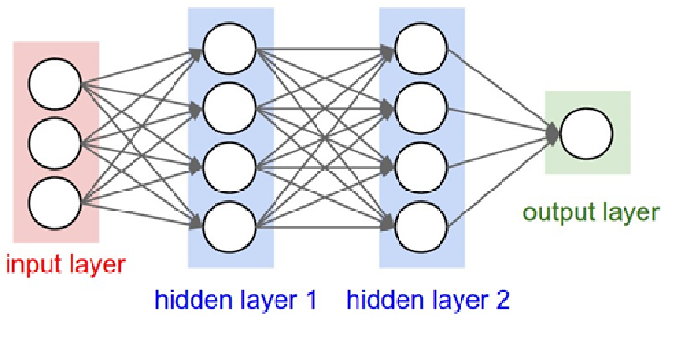
Convolutional Neural Network
A Convolutional Neural Network (CNN) is a type of feedforward Artificial Neural Network in which the connectivity pattern between its neurons is inspired by the organization of the animal visual cortex.
Convolutional Neural Networks consist of neurons that have learnable weights and biases. Each neuron receives some input, performs a dot product and optionally follows it with a non-linearity.

Slide 2
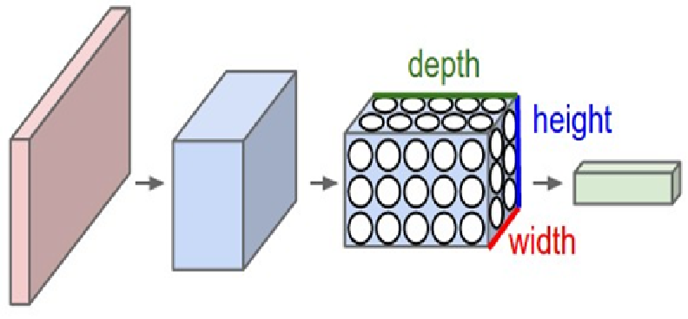
The whole Convolutional Neural Network expresses a differentiable score function that is further followed by a Softmax function.
The data input into the Convolutional Neural Network is arranges in the form of its width, height and depth

Slide 3
Layers of Convolutional Neural Network
A CNN consists of a lot of layers. These layers when used repeatedly, lead to a formation of a Deep Neural Network. Three main types of layers used to build a CNN are:
1. Input: This layer holds the raw pixel values of image.
2. Convolutional Layer: This layer gets the results of the neuron layer that is connected to the input regions. We define the number of filters to be used in this layer. Each filter may be a 5x5 window that slider over the input data and gets the pixel with the maximum intensity as the output.
3. Rectified Linear Unit [ReLU] Layer: This layer applies an element wise activation function on the

Slide 4
image data. We know that a CNN uses back propagation. So in order to retain the same values of the pixels and not being changed by the back propagation, we apply the ReLU function.
4. Pooling Layer: This layer perform a down-sampling operation along the spatial dimensions (width, height), resulting in volume.
5. Fully Connected Layer: This layers is used to compute the score classes i.e which class has the maximum score corresponding to the input digits.

Slide 5
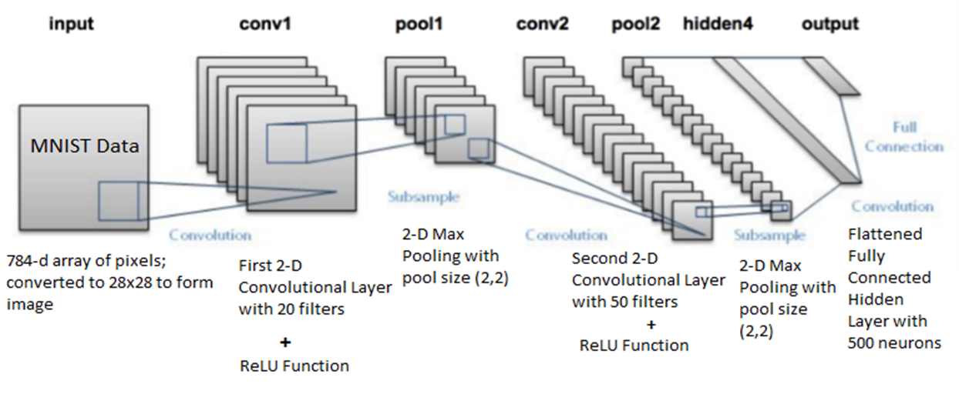

Slide 6
Literature survey
Method | Accuracy | Description
Hand printed symbol recognition.[5] | 97% overall. | Extract geometrical, topological and local measurements required to identify the character.
OCR for cursive handwriting. [6] | 88.8% for exicon size 40,000. | To implement segmentation and recognition algorithms for cursive handwriting.
Recognition handwritten numerals based upon fuzzy model.[13-14] | 95% for Hindi and 98.4% for English numerals overall. | The aim is to utilize the fuzzy technique to recognize handwritten numerals for Hindi and English numerals.
Combining decision multiple connectionist classifiers for Devanagari numeral recognition. [7] | 89.6% overall. | To use a reliable and an efficient technique for classifying numerals.
Hill climbing algorithm for handwritten character recognition. [10] | 93% for uppercase letters. | To implement hill climbing algorithm for selecting feature subset.
Optimization of feature selection for recognition of Arabic characters. [11] | 88% for numbers and 70% for letters. | To apply a method of selecting the features in an optimized way.
Handwritten numeral recognition for six popular Indian scripts. [12] | 99.56% for Devanagari, 98.99% for Bangla, 99.37% for Telugu, 98.40% for Oriya, 98.71% for Kannada and 98.51% for Tamil overall. | To find out the recognition rate for the six popular Indian scripts.

Slide 7
Percent Accuracy of Each Classification Technique
 | RFC | KNN | SVM | CNN
Trained Classifier Accuracy | 99.71% | 97.88% | 99.91% | 99.98%
Accuracy on Test Images | 96.89% | 96.67% | 97.91% | 98.72%
Classifier Error Rate Comparison
Model | Test Error Rate
Random Forest Classifier | 3.11%
K Nearest Neighbors | 3.33%
Supervised Vector Machine | 2.09%
Convolutional Neural Network | 1.28%

Slide 8
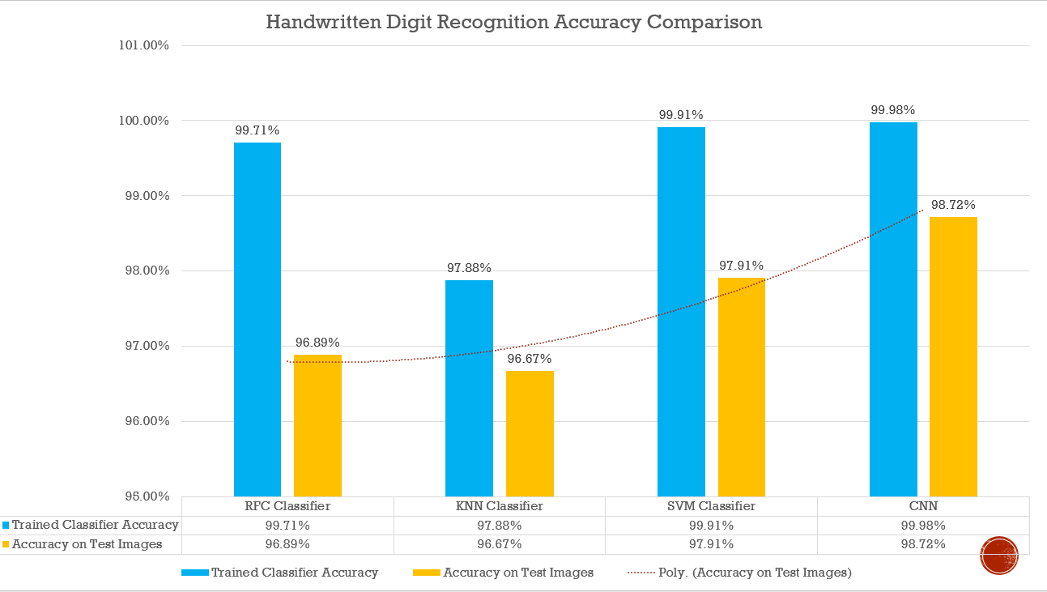

Slide 9
Phases of the Convolutional Neural Network
The CNN for Handwritten Digit Recognition works in three main phases.
Phase1 - Input MNIST Data1: The first phase is to input the MNIST data. The MNIST data is provided as 784-d array of pixels. So firstly we convert it to grayscale images using 28x28 matrix of pixels.
Phase2 – Building Network Architecture: In the second phase, we define the models to be used to build a convolutional neural network.
a)First Convolution Layer: In the first layer, we take 16 convolutional filters that go as a sliding window of size 5x5 over all the images of 28x28 matrix size and try to get the pixels with most intensity value.
b)ReLU Function: We know that convolution is a method that uses Back Propagation. So using the ReLU function as the activation function just after the convolutional layer reduces the likelihood of the vanishing gradient and avoids sparsity. This way we don‟t lose the important data and even get rid of redundant data like a lot of 0‟s in the pixels.

Slide 10
c) Pooling Layer: The pooling layer gets the data from the ReLU function and down-samples the steps in the 3D tensor. In short it pools all the pixels obtained from previous layers and again forms a new image matrix of a smaller size. These images are again input into the second set of layers i.e. “CONV =>ReLU=> POOL” and this process goes on till we get to a smallest set of pixels from which we can classify the digit.
Phase 3 –Fully Connected Layer: The fully connected layer is used to connect each of the previous layers to the next layers. This layer consists of 128 neurons. Finally, we apply a Softmax Classifier that returns a list of probabilities for each of the 10 class labels. The class label with the largest probability is chosen as the final classification from the network and shown in the output.
This output received is used to make the confusion matrix for the model. In this we can add more number of layers but adding more layers might affect the accuracy of the system. Since, it uses multiple layers, so it’s called a Deep Learning system.

Slide 11
Tools and Technologies to be used
Tools
Keras
Theano/TensorFlow
Python
Scikit-learn
Technology
Deep Learning (Convolutional Neural Network)

Slide 12
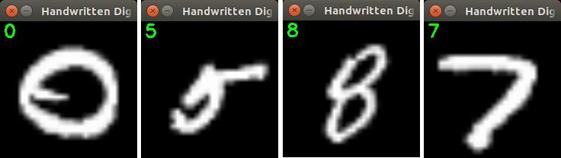
Overview of MNIST Dataset
MNIST Dataset The MNIST dataset, a subset of a larger set NIST, is a database of 70,000 handwritten digits, divided into 60,000 training examples and 10,000 testing samples. The images in the MNIST dataset are present in form of an array consisting of 28x28 values representing an image along with their labels. This is also the same in case of the testing images. The data is stored in four files:
1. train-images-idx3-ubyte: training set images
2. train-labels-idx1-ubyte:training set labels
3. t10k-images-idx3-ubyte: test set images
4. t10k-labels-idx1-ubyte: test set labels

Slide 13
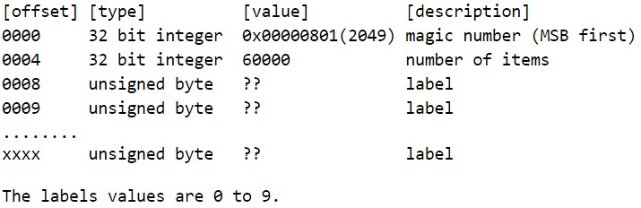
Training set labels

Slide 14
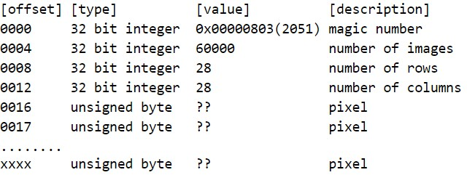
Training set Image

Slide 15
MNIST dataset format analysis
As you can see from above, the MNIST data is provided in a specific format. So, to be able to read the dataset it is first important to know that in what format the data is available to us. Both the Training and Testing images and labels have the first two columns consisting of the “Magic Number” and the number of items in the file.
The magic number has its first two bytes equal to zero. This magic number is read as MSB first and its format is as shown below:
2 Bytes | 1 Byte | 1 Byte
00 | Data Type | Dimensions
2 Bytes | Data Type | Dimension
00 00 | 08 | 03

Slide 16
Reading the MNIST Dataset
To read in the MNIST dataset, I have written a python code with class “MNIST” and defined the functions inside this class. The basic outline of the code can be summarized as follows:
Read the MNIST dataset files using python .
For each file, there is a specific magic number. Take the data files one by one and read them if the condition for the magic number is satisfied i.e. if the magic number matches the type of the file.
For example, to read the Training Set Image data file, you need to check first if the magic number is equal to 2051 else don’t read the file for training labels.
Read the number of rows and columns provided in the data file in next row to the magic number.
The using this information, read the 28x28 data corresponding to the respective label provided in the row-wise format.
Follow the above steps for rest of the files and put the respective data in the variables.

Slide 17
Applications
Writer Recognition
Extracting business card information
Bank Cheque Processing
Postal Address Interpretation
Automatic Number plate recognition
Data Entry for business documents
Eg: Bank Statement and receipt, passport, invoice

Slide 18
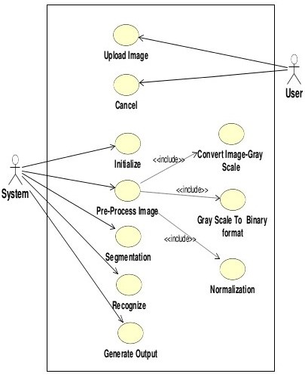
UML Diagrams
Use Case Diagram

Slide 19
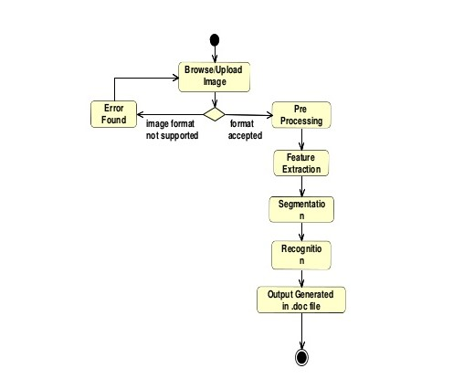
Activity Diagram

Slide 20
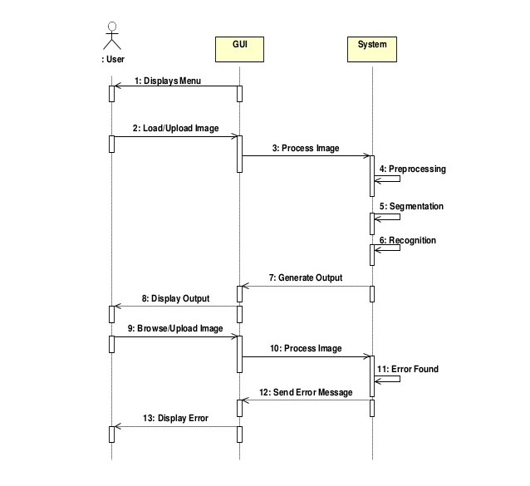
Sequence Diagram

Slide 21
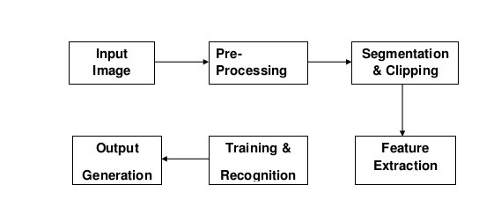
Architecture Diagram

